Slide 1
East Suffolk Council – delivering in Lowestoft
Cllr Steve Gallant, Leader of the Council
Cllr Craig Rivett, Deputy Leader & Cabinet Member for Economic Development

Slide 2
Opportunities in Lowestoft
Clean energy + marine sector growth
Tourism
Major investment in infrastructure
Enterprise Zones
Heritage Action Zones
Historic environment
Adopted Cultural Strategy
An exemplar Local Cultural Education Partnership​​

Slide 3

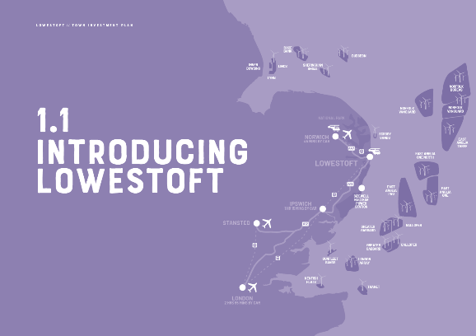
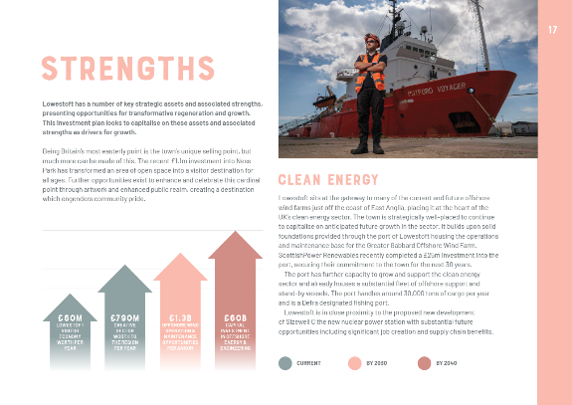
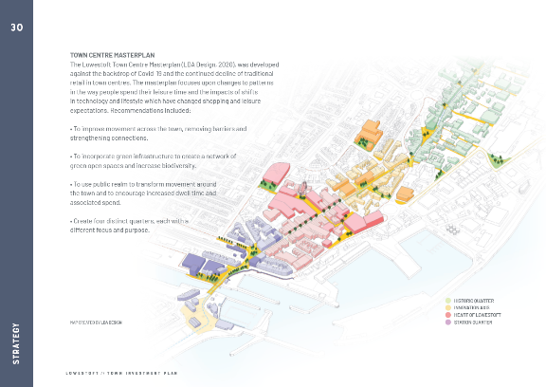
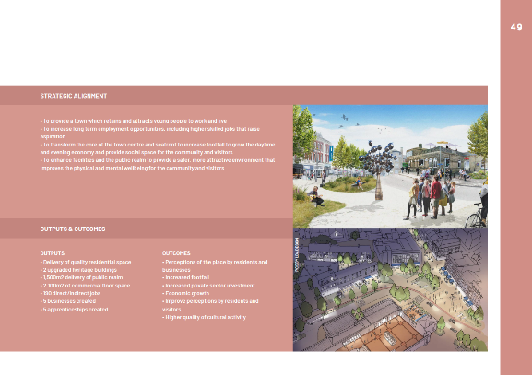
Lowestoft Investment Plan
Ambitious plan to deliver over £350m of regeneration projects over the next 10 years
Will attract jobs, business and new homes
Developed in partnership through the Lowestoft Place Board (private, voluntary and public sector representation)
£24.9m Town Deal
Place Board has agreed 5 priority projects and business cases have been submitted for each
These projects to be completed within 5 years of sign off

Slide 4
The 5 priority projects are …
  Cultural Quarter (£14.7m) - redevelopment of Battery Green Car Park/Marina Customer Service Centre with commercial offer and a range of cultural and leisure uses + upgrades to the Marina Theatre and public realm
  Historic Quarter (£3.3m) - conservation-led approach to improving the built environment to create a sense of place and adding to the visitor destination offer
  Station Quarter (£2.9m) - redevelopment of the derelict part of the railway station and former Post Office and enhanced public realm
  Port Gateway Improvements (£2.7m)
  Seafront Vision (£1.3m) - improved public realm along 1.5 miles of promenade + landmark water installation experience and redevelopment of East Point Pavilion

Slide 5
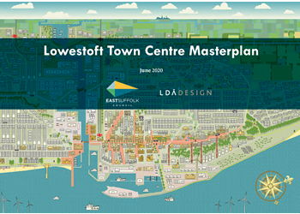
Town Centre Masterplan
Our response to the challenges the town centre faces
Developed in partnership
A plan to create a prosperous town centre as a place in which to live, work or have fun
Blueprint for change over the next 10-15 years
Incorporates more short-term plans which will help bring activity, jobs and business
Considers ways to re-purpose and guide future development and secure inward investment

Slide 6
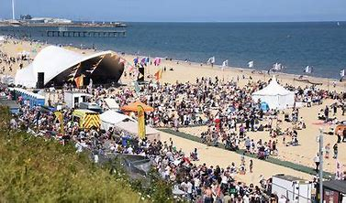
First Light Festival + East Point Pavilion
Free 24-hour multi arts festival celebrating one cycle of midsummer returns on 18 and 19 June
£200k investment from ESC
Will coincide with the reopening of East Point Pavilion:
  £720k refurbishment
  Food from an assortment of independent street food traders + house bar and café
  Year-round schedule of live music, artisan markets and community-led workshops and events

Slide 7
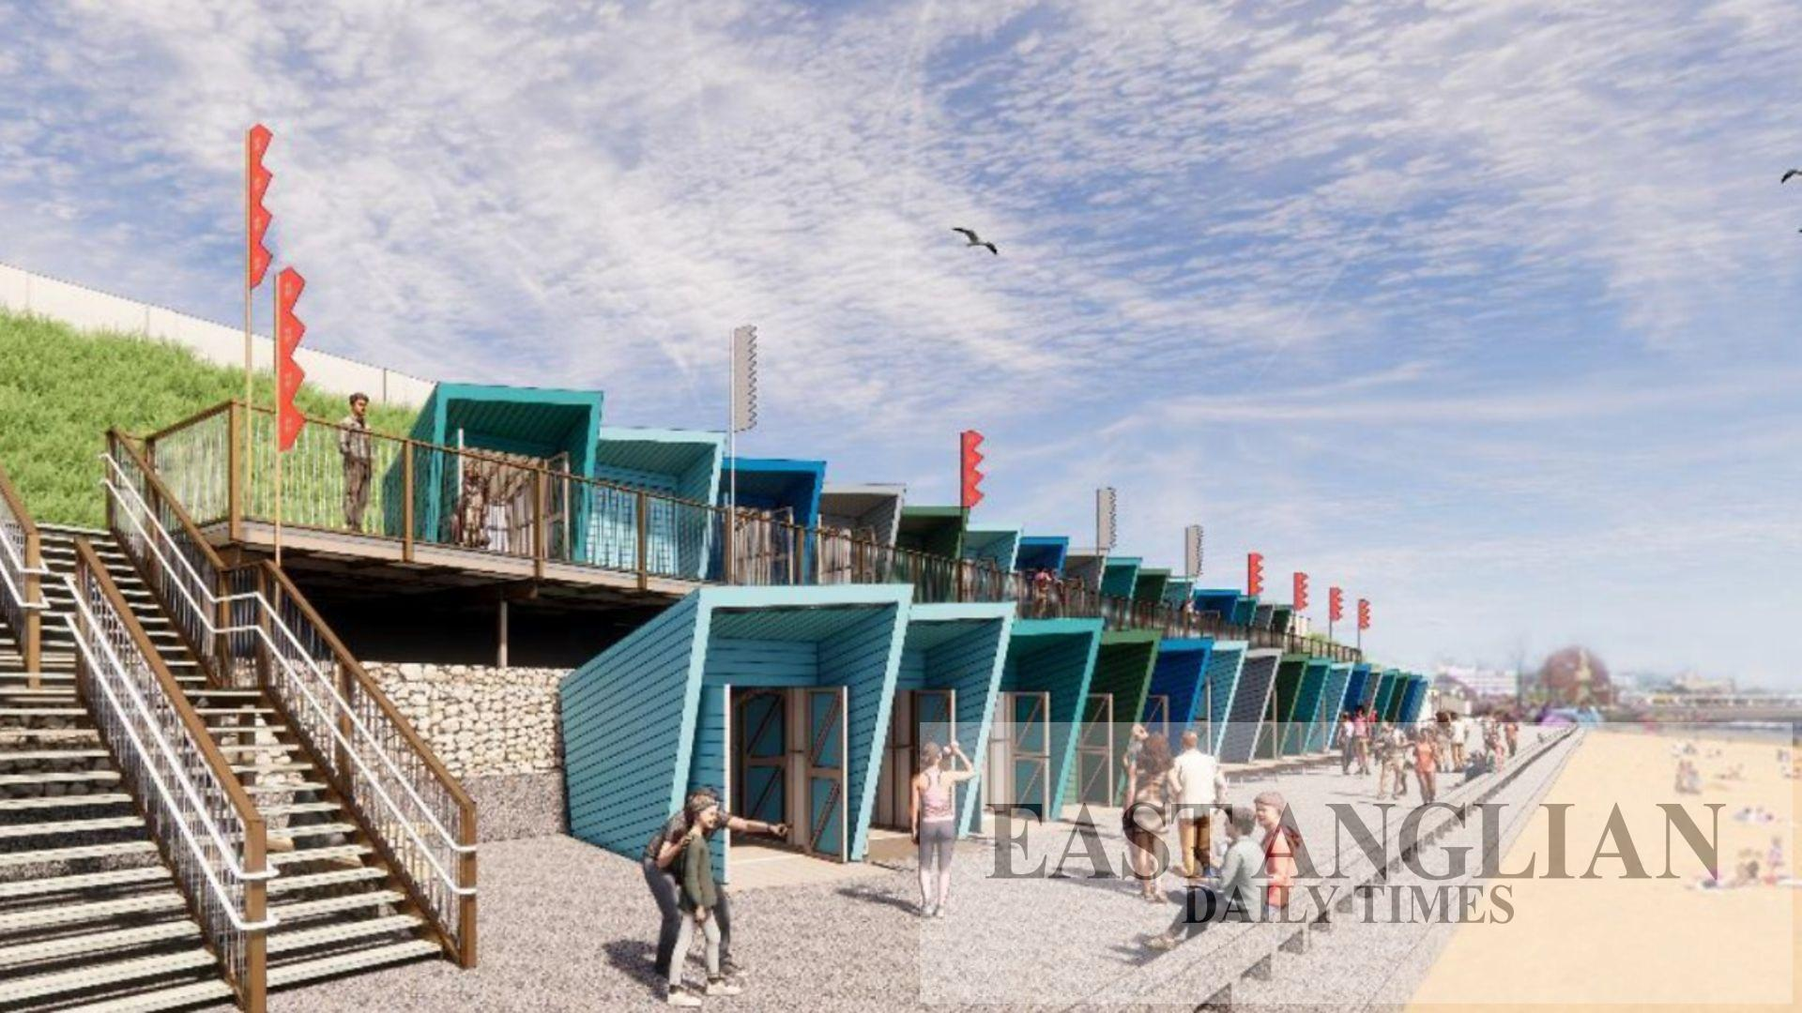
Beach Huts
ESC Planning Committee approved 72 contemporary beach huts for Jubilee Parade
£2.6m investment
Split level huts and raised decking to allow full access to the promenade
Some huts will be accessible
Completion scheduled for August

Slide 8
East Suffolk Services
New trading company incorporated to deliver crucial services such as waste and recycling collection, grounds maintenance and street cleansing
Will operate as an ‘arms-length’ commercial business from July 2023 following the end of the contract with Norse
New Managing Director appointed with strong, commercial leadership to drive performance, ensure sound financial management and value for money for taxpayers

Slide 9
Waterlane Leisure Centre
Reopened in May 2021 following improvement works and modernised fitness facilities including:
  £400k new gym equipment
  New flooring in the gym and sports hall
  Upgrades to lighting
  Showers repaired
  Improved pool area and new moveable floor in the teaching pool
£1m aesthetic makeover
Key priority to get more people active

Slide 10

Lowestoft and Northern Parishes Community Partnership
Three priorities:
  Tackle Childhood Obesity
  Social Isolation and Loneliness
  Mental Health and Wellbeing
Annual budget of £25k + opportunity to bid from central pot or pool resources with other CPs

Slide 11
Budget allocation for 2021/22
Amount | Project
£4,992.00 | Sunday Club (for young people to address social isolation/anxiety)
£4,992.00 | Walk in the Park (reduce social isolation/anxiety)
£1,940.00 | Boys Respect Group (support group for those with early stages of poor mental health/reduced wellbeing)
£1,200.00 | Oulton Happy Circle Club (assist reopening)
£1,200.00 | Blundeston Play Park (repair equipment)
£1,270.83 | Somerleyton School Allotment (outdoor allotment classroom)
£2,000.00 | Lowestoft & Gt Yarmouth Rugby Club minibus (extension of service)
£2,139.00 | Re-utilise (furniture and supplies for wellbeing craft club drop in)
Total | 19,733.83

Slide 12
Outcomes
Voice of a friend (administered by Citizens Advice with funding from the CP)
Lowestoft Mile – 4 walks filmed and launched with a fifth on the way + Walk in the Park
Young People’s obesity project
Community engagement event held in February to help strengthen the partnership

Slide 13
More generally
Community Intervention Team’s outreach work at Sam’s Café, Food Bank and other Lowestoft locations to support seldom heard individuals + supporting the vaccine bus as it tries to raise vaccination levels across the town
Emerging Cost of Living programme which will build on some of the pilots in Lowestoft such as Thin Ice, Your Local Pantry etc – secured £29k for a 6 month Food Network post and four new pantries in the town
New Financial Inclusion Team to work with residents who need advice about debt, benefits, budgeting and credit
Holiday Activity and Food programme – funding from the Community Partnership of £126k to provide free school meals

Slide 14
Digital Towns Programme
Free-to-use public wi-fi launched (from the seafront to the town centre including Kirkley High Street and the Triangle)
Includes digital footfall counters and town marketing platforms alongside a business support programme
Support local businesses to improve services and offerings to attract more customers
Will make it easier for visitors and local people to get online when out and about
Will also enable the Council to understand the number of visitors, the busiest periods, the average time people spend here etc so we can provide tailored support for local businesses and provide data-based evidence to support other projects

Slide 15

QUESTIONS?

